Slide 1

Du-Parking: Spatio-Temporal Big Data Tells You Realtime Parking Availability

Slide 2
Problem
A significant portion of the traffic in big cities is caused by searching for parking spaces, which is responsible for up to 40% of the total traffic within cities.
There are limited realtime parking availability systems in a city due to the expensive cost of sensor device and maintaining realtime parking information.

Slide 3
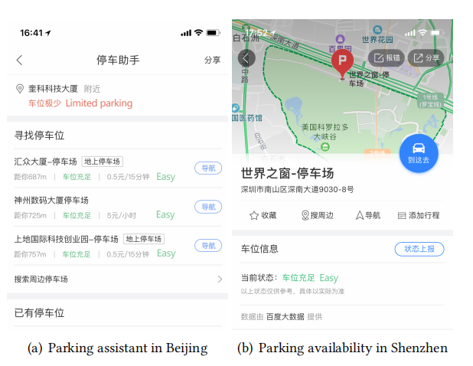

Slide 4

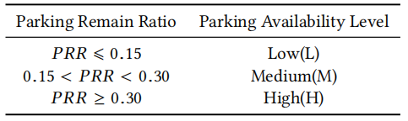



Definition
PRR
parking free denote the number of free parking spaces
parking total denotes the total number of parking spaces
Problem Statement
$$p.A\left(p∈P_{1}\right) → p^{′}.A(p^{′}∈P_{2})$$

Slide 5
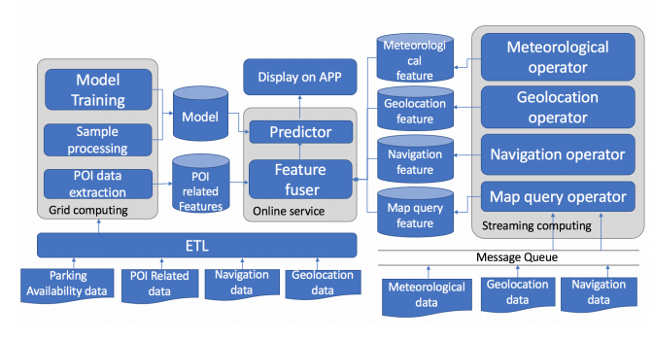
Framework

Slide 6
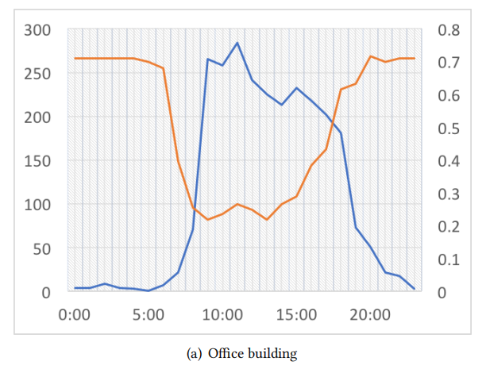
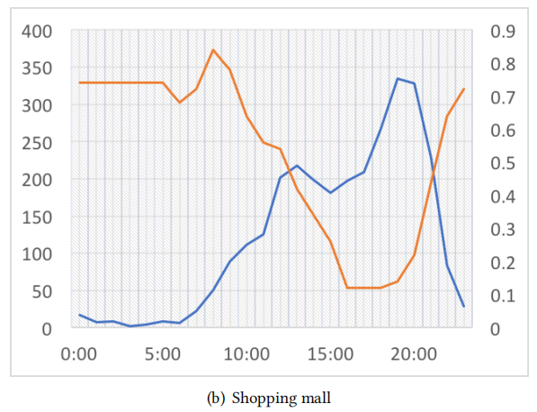
Feature Extraction
Orange: parking availability Blue: geolocation visitor number

Slide 7
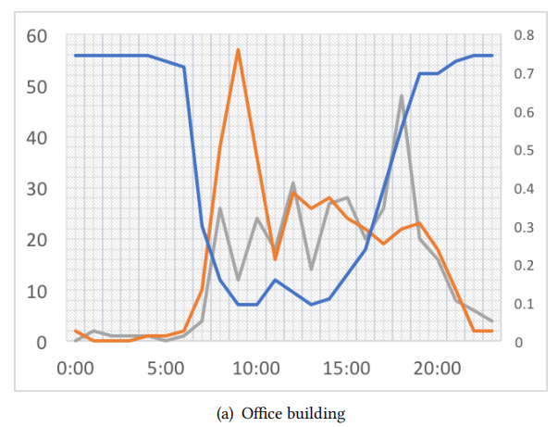
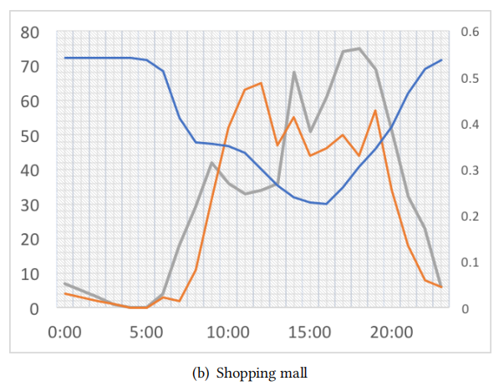
Orange: unique visitors arriving Gray: unique visitors leaving Blue: PRR

Slide 8
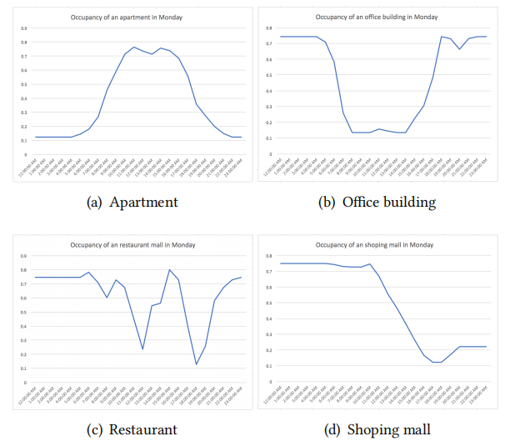
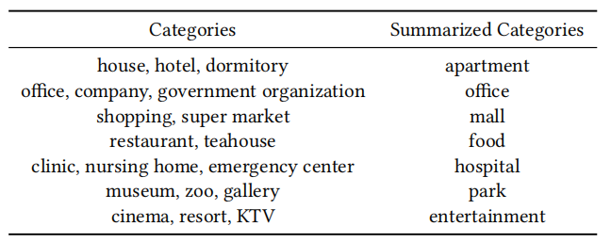
POI-related Features

Slide 9
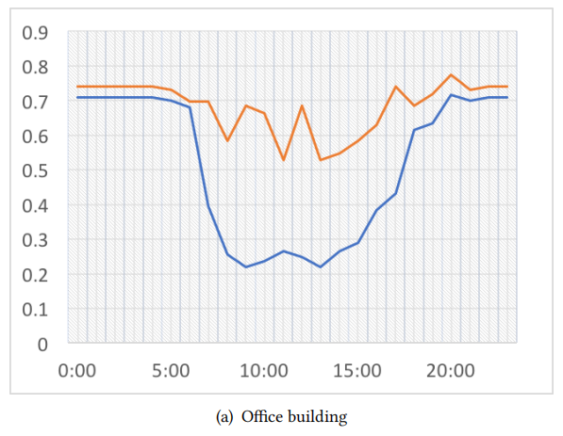
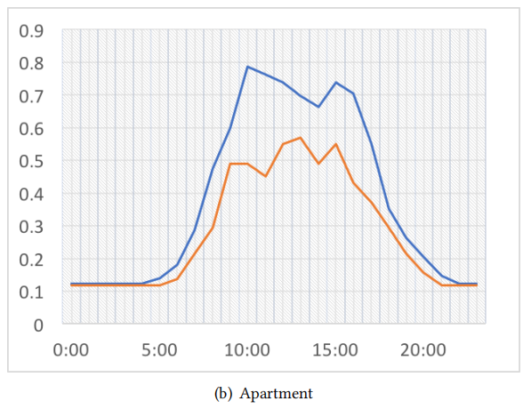
Orange: PRR in weekend Blue: PRR in weekday

Slide 10
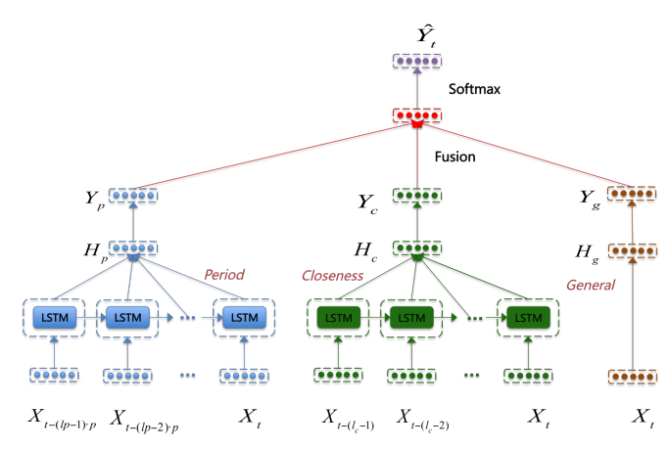

Model

Slide 11
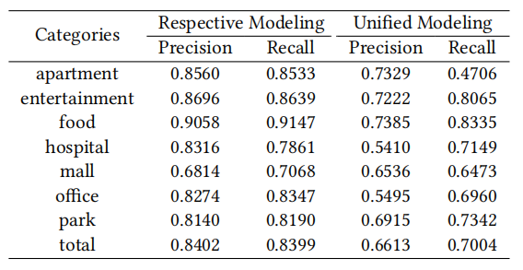
Experiments
Respective Modeling VS Unified Modeling

Slide 12
